Slide 1

Twitter Bot With Python

Slide 2
Information
Approximately 500 million tweets are published every day — and not all of them from human users. In fact, if you’ve ever retweeted an article on Twitter, the chances are high that the tweet was created by a bot instead of a human user. Marketer learning how to make a twitter bot A study by Pew Research estimates that two-thirds of all tweeted links are shared by suspected bots. As bots continue to be more prolific on this popular social media platform, it’s important to understand what a Twitter bot is exactly. You might even need to know how to make one. Since a bot can automate part or all of your Twitter activity, it can accelerate your Twitter marketing strategy while saving you time. Let’s take a closer look at what a Twitter bot is and what benefits it offers below. What is a Twitter bot? A Twitter bot is an account that’s programmed to perform actions, like send tweets at a scheduled time or follow accounts. These bots are created and managed via the Twitter API. By automating certain tasks, Twitter bots can help you establish an active presence on one of the most widely used social media platforms in less time. With a bot, you can schedule tweets to publish at times when you’re not online. You can automate responses to new followers. You can retweet content with a particular keyword or hashtag. You can follow or unfollow accounts — and much more.

Slide 3
1.
What is a Twitter bot used for?

Slide 4
Twitter bots can be used for helpful purposes, such as broadcasting important content like weather emergencies in real time. They also can be used for malicious purposes such as spreading fake news and spam.

Slide 5
2.
How are Twitter bots made?

Slide 6
Twitter bots are automated Twitter accounts that are set up with bot software. They’re programmed to perform tasks that resemble those of everyday Twitter users such as liking tweets, but their purpose is to tweet and retweet content for specific goals on a large scale.

Slide 7
3.
What are Twitter bot scams?

Slide 8
Cybercriminals can use these Twitter bots, or artificial automations, on a large scale, which enables them to use them in larger scams. These scams include things like spreading malicious content that contains malware to large groups of Twitter users at the same time or spreading political propaganda to influence elections.

Slide 9
4.
How prevalent are Twitter bots?

Slide 10
The prevalence of Twitter bots is up for debate, as seen in Elon Musk’s backing out of a deal to buy Twitter due to the uncertainty surrounding this very question — and Twitter’s alleged resistance to provide greater clarity on the issue.

Slide 11
5.
Are Twitter bots legal?

Slide 12
Twitter bots are not illegal. The key is that a Twitter bot must follow the social media platform’s rules, which include refraining from using the service for malicious purposes like artificially amplifying or suppressing information.

Slide 13
6.
What is Twitter doing to combat bots?

Slide 14
Twitter suspends millions of bot accounts every month for malicious uses of its platform. These prohibited uses include malicious automation, creating multiple accounts for malicious purposes, fake and aggressive engagements, and spamming.

Slide 15
7.
Let’s see what we have used to create Twitter bot

Slide 16
Gecko Driver
Gecko Driver is a web browser engine which is used in many applications developed by Mozilla Foundation and the Mozilla Corporation. Gecko Driver is the link between your tests in Selenium and the Firefox browser. Gecko Driver is a proxy for using W3C WebDriver-compatible clients to interact with Gecko-based browsers

Slide 17
Firefox
Mozilla Firefox, or simply Firefox, is a free and open-source web browser developed by the Mozilla Foundation and its subsidiary, the Mozilla Corporation. It uses the Gecko rendering engine to display web pages, which implements current and anticipated web standards.

Slide 18
VS Code
Visual Studio Code, also commonly referred to as VS Code, is a source-code editor made by Microsoft with the Electron Framework, for Windows, Linux and macOS. Features include support for debugging, syntax highlighting, intelligent code completion, snippets, code refactoring, and embedded Git.

Slide 19
Python
Python is a high-level, general-purpose programming language. Its design philosophy emphasizes code readability with the use of significant indentation via the off-side rule. Python is dynamically typed and garbage-collected

Slide 20
8.
Let’s have a look on source code

Slide 21
Source Code
from selenium import webdriver
from selenium.webdriver.common.by import By
from selenium.webdriver.common.keys import Keys
import time
class TwitterBot:
def _init_(self,username,password):
self.username = username
self.password = password
self.bot = webdriver.Firefox()

Slide 22
Source Code
def login(self):
bot = self.bot
bot.get('https://twitter.com/i/flow/login')
time.sleep(5)
email = bot.find_element(By.NAME, 'text')
email.send_keys(self.username)
email.send_keys(Keys.RETURN)
time.sleep(3)

Slide 23
Source Code
password = bot.find_element(By.NAME, 'password')
password.send_keys(self.password)
password.send_keys(Keys.RETURN)
time.sleep(3)
ed = TwitterBot('', '')
ed.login()

Slide 24
9.
How to use Twitter bot

Slide 25
How to use Twitter bot we just have to insert our email id and password and it will automatically open your Firefox browser and opens the Twitter official site it just enters your email id and password and sign in your account.

Slide 26
10.
What else we can do with twitter bot in future

Slide 27
We can insert many things like auto-liking the tweets, auto-post tweets, we can schedule our tweets accordingly as we want, we can scrape twitter data and more.

Slide 28
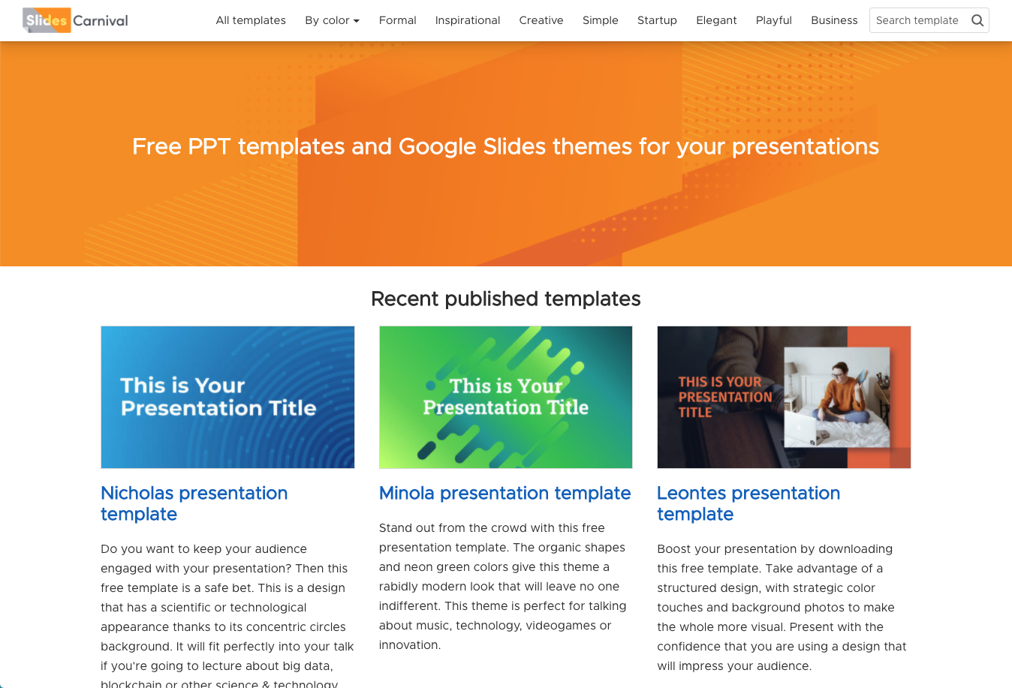
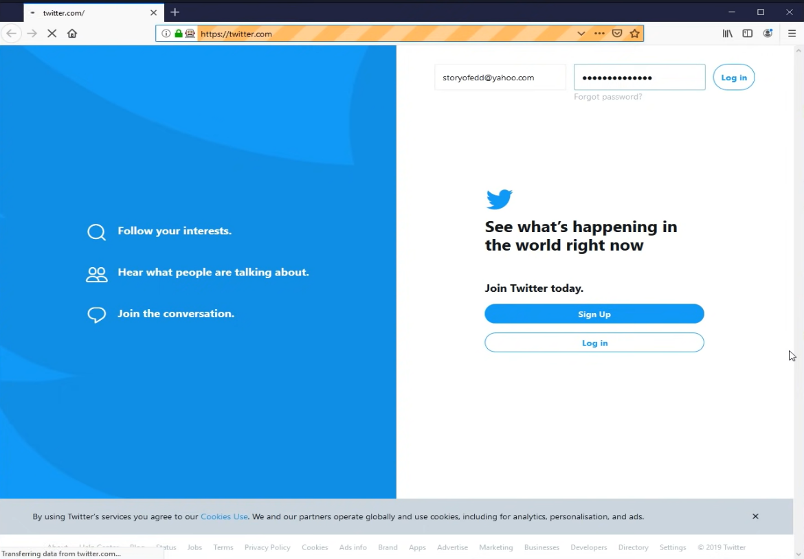
Output

Slide 29
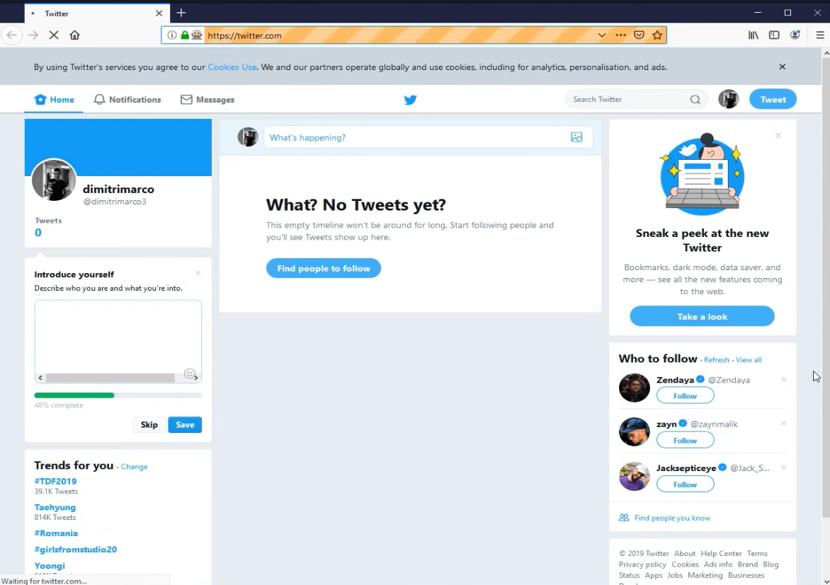
Output

Slide 30
Conclusion
Hence we have successfully done with the "Twitter bot" execution with the use of python and code run/executed using VS code. We have made this to make easy to login with individual twitter handles of specific user. This is very useful because it just has your information like your username, password already filled/it will auto-fill your required information. And once done with that it will open the "Firefox" Browser and login. And then you can see the twitter logged interface on your pc/laptop screen.

Slide 31
Reference Links
Python
https://www.python.org/downloads/
Firefox
https://www.mozilla.org/en-US/firefox/new/
P
F
https://github.com/mozilla/geckodriver/
Gecko Driver
https://www.youtube.com/watch?v=7ovFudqFB0Q
YouTube
G
Y

Slide 32
Team Presentation
Team Leader
Sarvesh Kadam
Members
Atharva Shelke
Omkar Udage
Anuja Khade

Slide 33
Thank You!

